Slide 1
RNA-seq data analysis: Introduction to DESeq2
Akul Singhania
Bioinformatics meeting
10/25/2019

Slide 2
A typical RNA-seq workflow
Sequencing
Raw fastq files
Mapping and Alignment (TopHat/STAR)
Quantification (htseq-count/featureCounts)
Raw counts
From the core

Slide 3
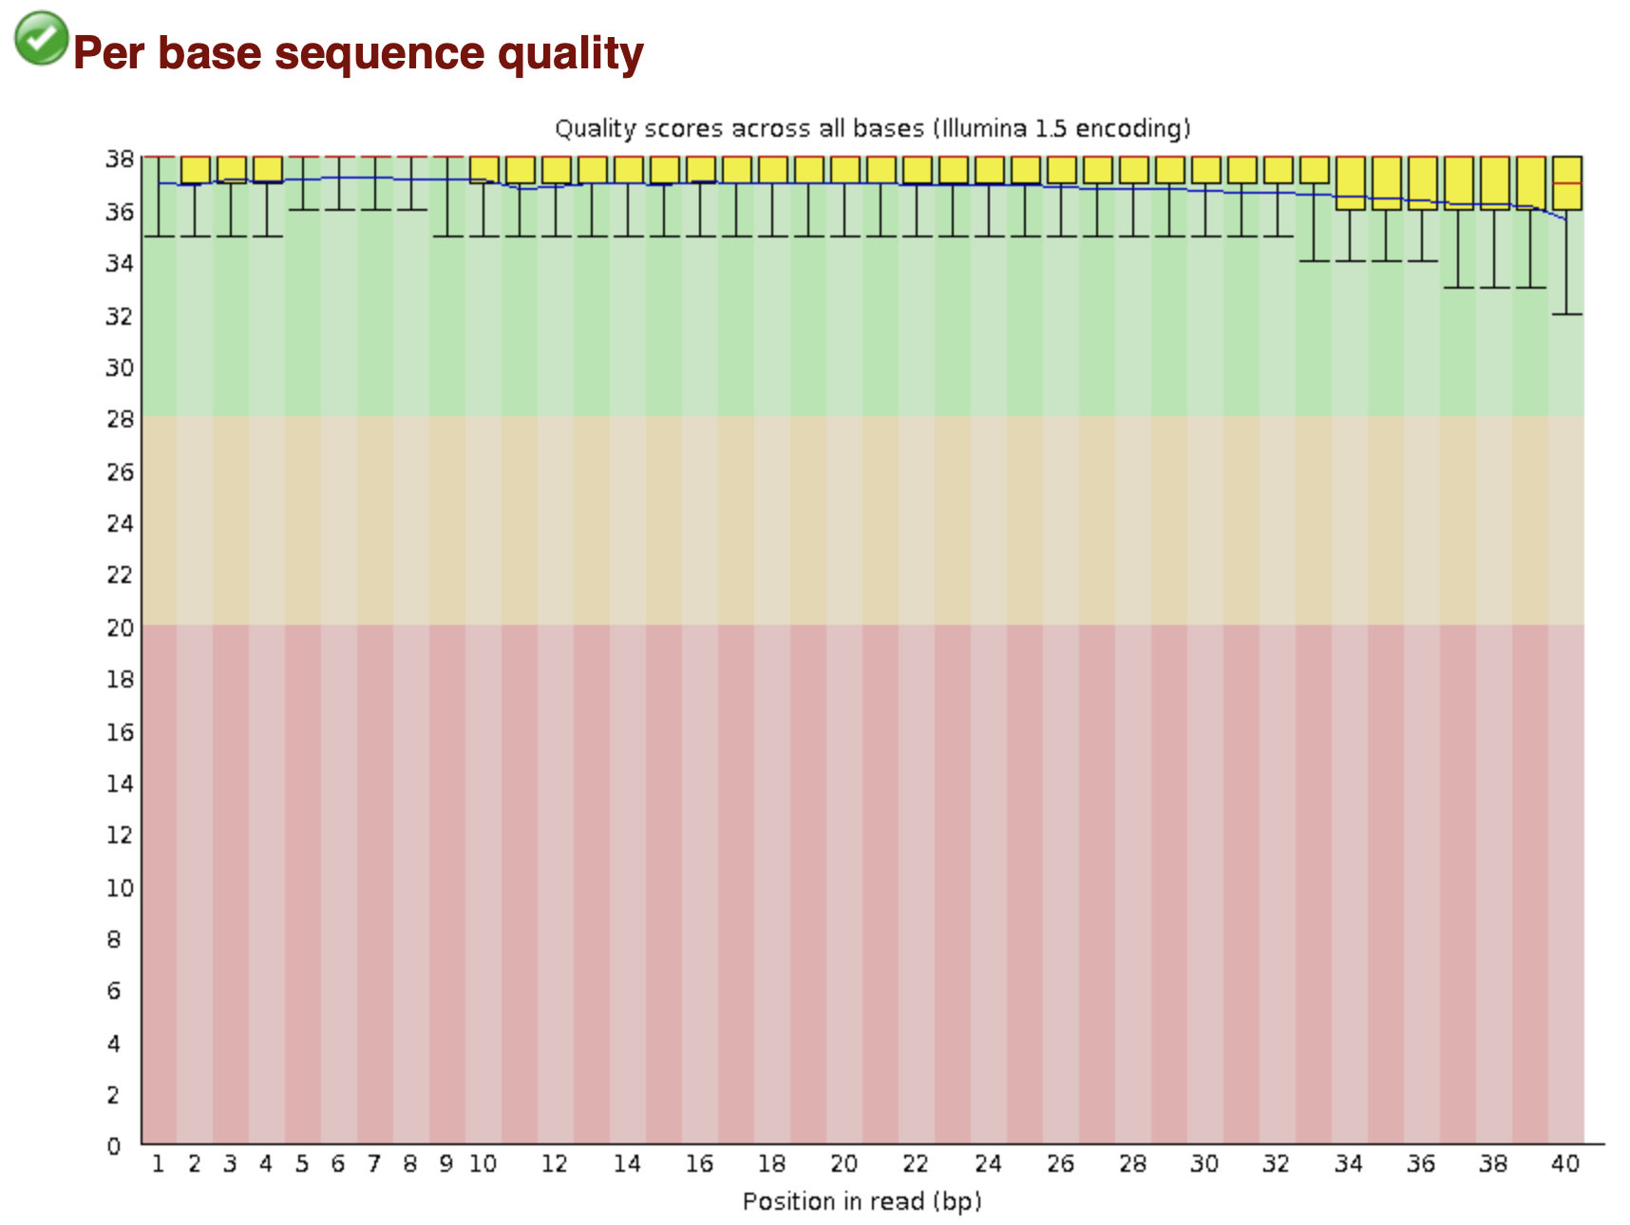
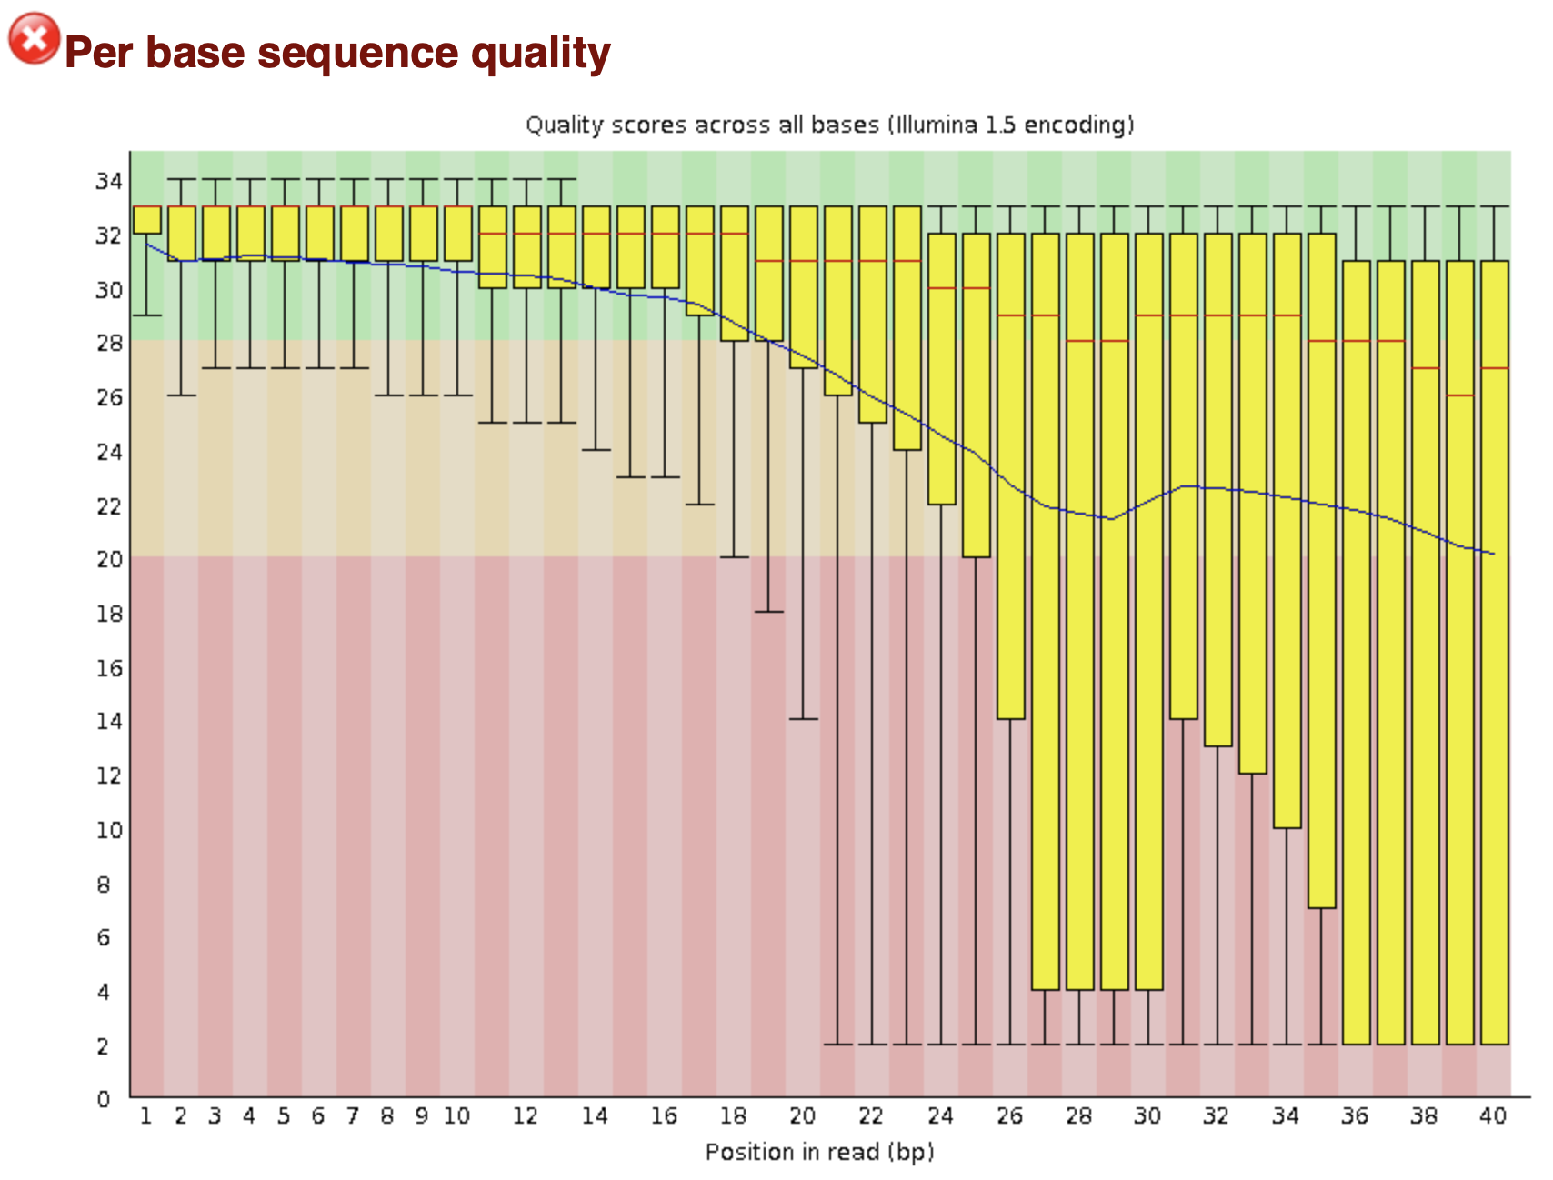
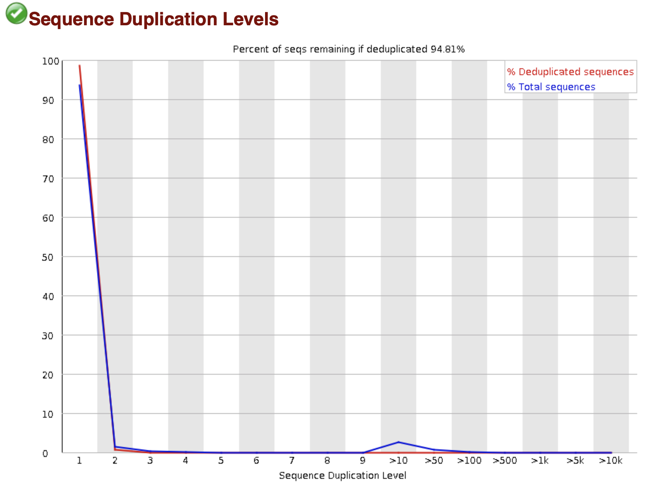
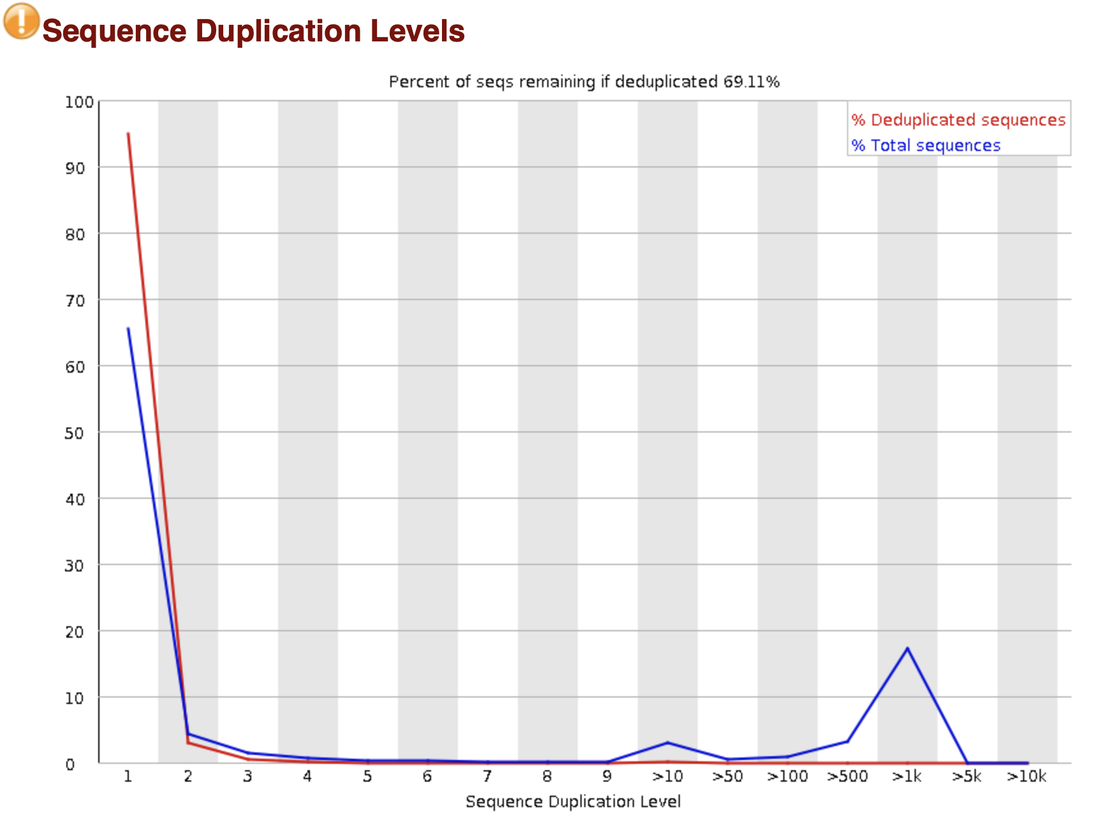
A typical RNA-seq workflow
Sequencing
Raw fastq files
Mapping and Alignment (TopHat/STAR)
Quantification (htseq-count/featureCounts)
Raw counts
FastQC
- Available from the Babraham Institute, Cambridge, UK
- A quality control tool for high throughput sequence data
From the core
Quality Control
https://www.bioinformatics.babraham.ac.uk/projects/fastqc/

Slide 4
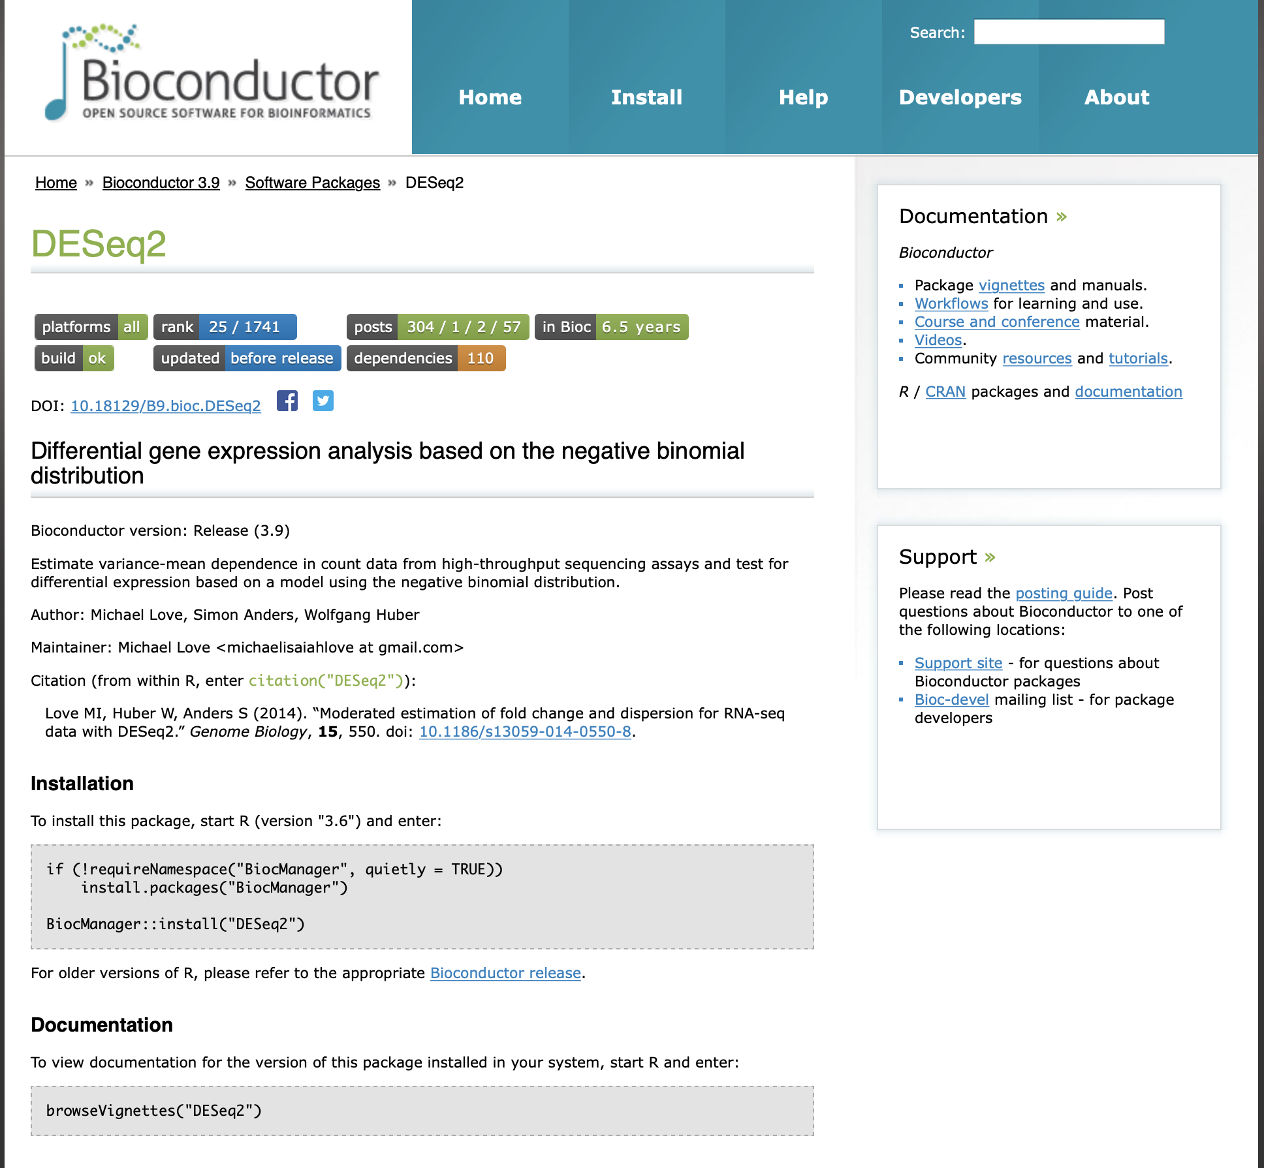
A typical RNA-seq workflow
Sequencing
Raw fastq files
Mapping and Alignment (TopHat/STAR)
Quantification (htseq-count/featureCounts)
Raw counts
From the core
Quality Control
Import raw counts into R

Slide 5
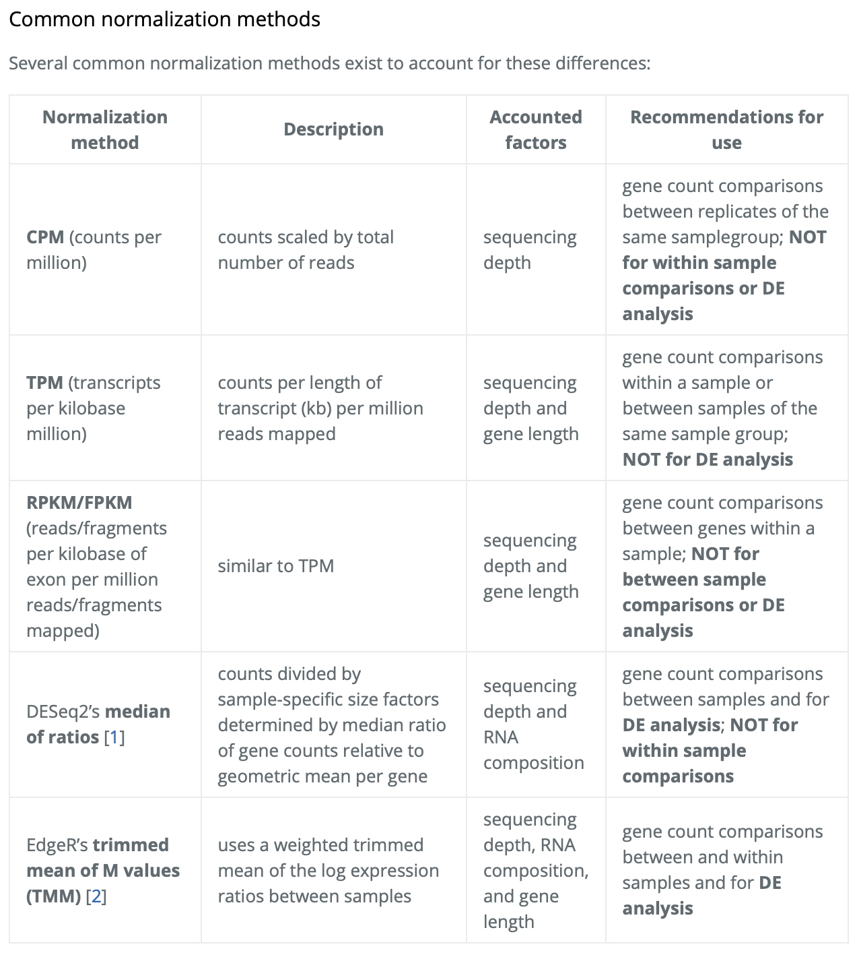
A typical RNA-seq workflow
Sequencing
Raw fastq files
Mapping and Alignment (TopHat/STAR)
Quantification (htseq-count/featureCounts)
Raw counts
From the core
Quality Control
Import raw counts into R
Normalization
https://hbctraining.github.io/DGE_workshop/lessons/02_DGE_count_normalization.html

Slide 6
A typical RNA-seq workflow
Sequencing
Raw fastq files
Mapping and Alignment (TopHat/STAR)
Quantification (htseq-count/featureCounts)
Raw counts
Microarray
Normal distribution
RNA-seq
Negative binomial distribution
From the core
Quality Control
Import raw counts into R
Normalization
Transformation (VST/rlog)
Lot of the tools and analysis performed in transcriptomics, such as PCA, heatmaps etc., assume that your data is normally distributed
So we can convert RNA-seq count data (negative binomial) into a log₂ space (normal distribution)
VST (variance stabilizing transformation)
runs faster and and is less sensitive to high count outliers.
usually recommended for medium-to-large datasets (n > 30)
rlog (regularized log transformation)
slow and relies more heavily on the assumption of the data distribution
usually recommended for small datasets (n < 30)

Slide 7
A typical RNA-seq workflow
Sequencing
Raw fastq files
Mapping and Alignment (TopHat/STAR)
Quantification (htseq-count/featureCounts)
Raw counts
Unnormalized data
Normalized data
From the core
Quality Control
Import raw counts into R
Normalization
Principal Component Analysis
Transformation (VST/rlog)
QC/PCA

Slide 8
A typical RNA-seq workflow
Sequencing
Raw fastq files
Mapping and Alignment (TopHat/STAR)
Quantification (htseq-count/featureCounts)
Raw counts
From the core
Quality Control
Import raw counts into R
Normalization
Transformation (VST/rlog)
QC/PCA
Differential gene expression analysis

Slide 9
A typical RNA-seq workflow
Sequencing
Raw fastq files
Mapping and Alignment (TopHat/STAR)
Quantification (htseq-count/featureCounts)
Raw counts
From the core
Quality Control
Import raw counts into R
Normalization
Transformation (VST/rlog)
QC/PCA
Differential gene expression analysis
Visualization & Functional enrichment

